Slide 1


NREGA ANALYSIS IN POWER BI

Slide 2
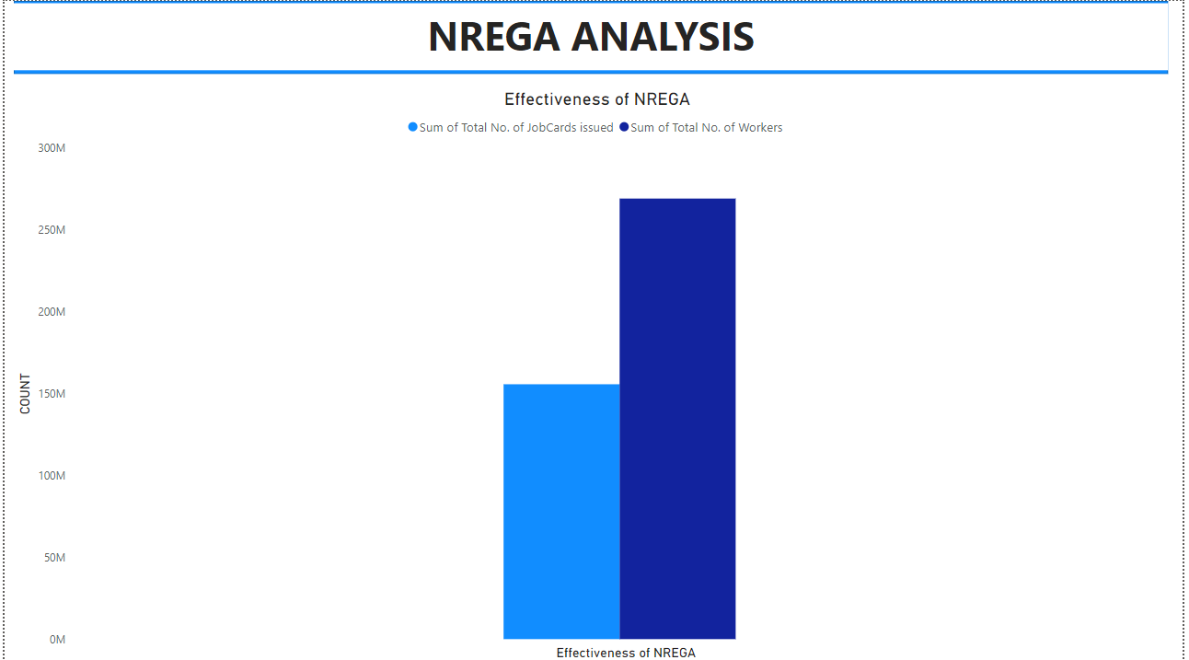

Slide 3
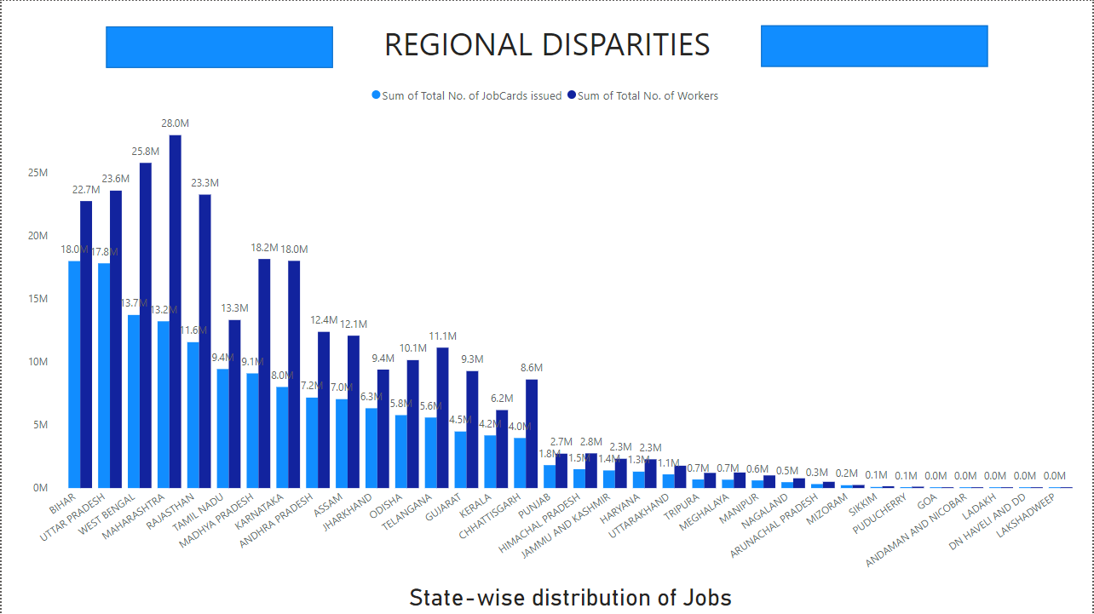

Slide 4
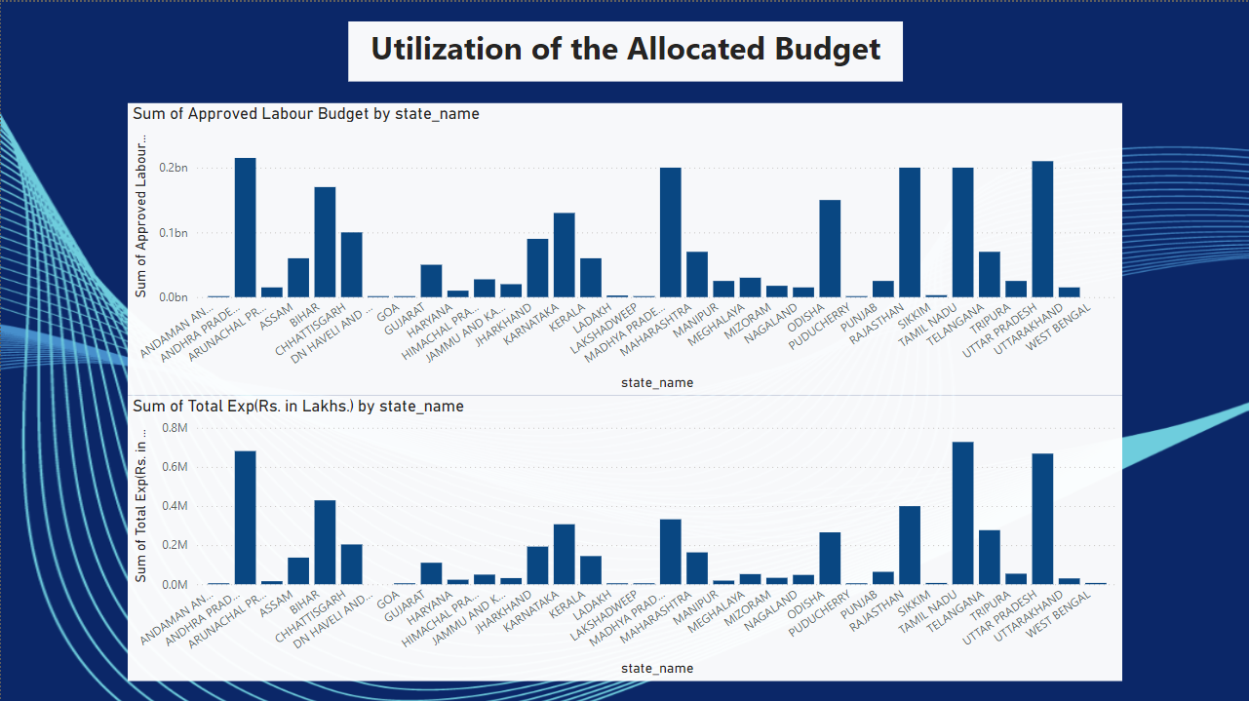

Slide 5
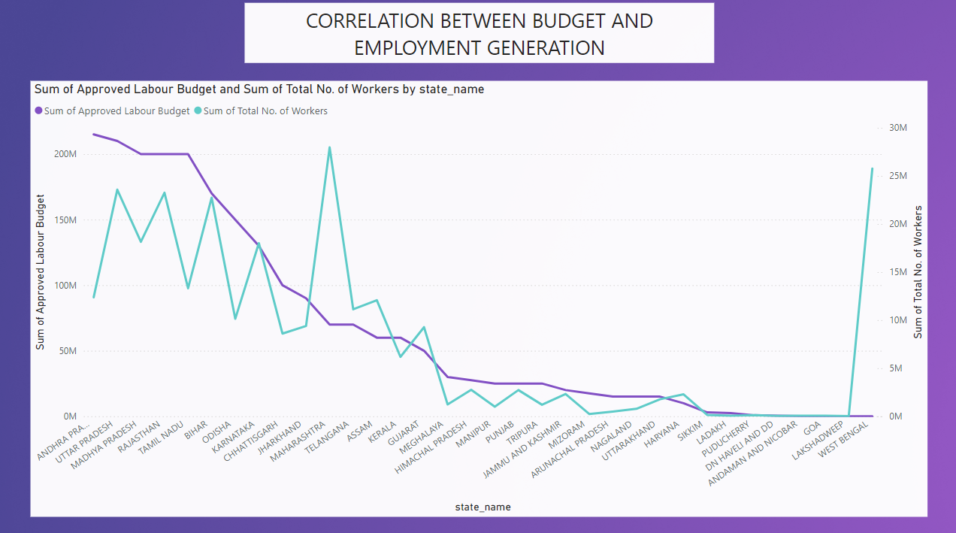

Slide 6
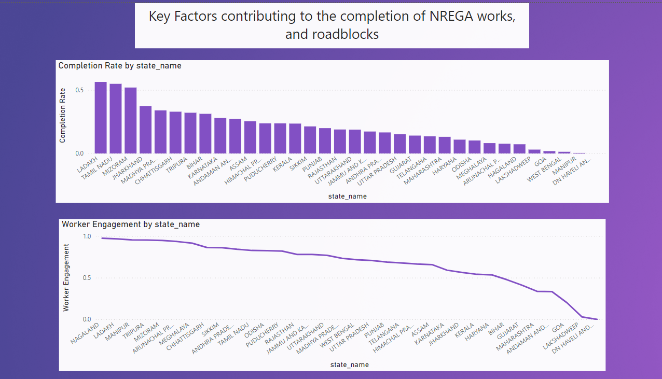

Slide 7
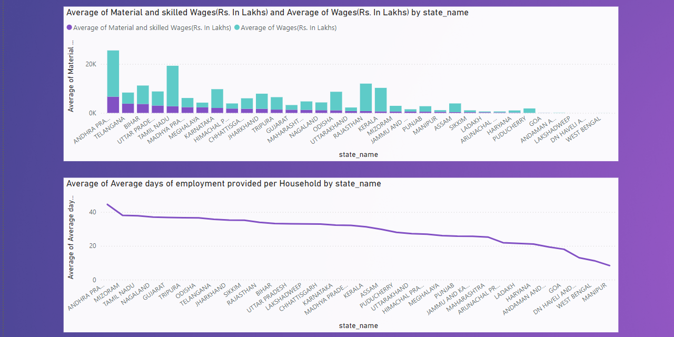

Slide 8

Can data-driven insights guide policymakers?
Data-driven insights can significantly guide policymakers and administrators in optimizing the NREGA scheme. By analyzing regional disparities, policymakers can direct resources to underperforming areas to ensure equitable employment opportunities. Assessing budget utilization helps in reallocating unspent funds to regions with higher demand. Understanding the relationship between worker engagement, productivity, and project completion can lead to improved strategies like providing incentives and training programs. Analyzing wage data ensures adequate financial support for rural households. Continuous monitoring and evaluation allow for timely adjustments to policies. Ultimately, these insights enable evidence-based decision-making, enhancing the scheme's overall effectiveness and impact.

Slide 9

THANK YOU

